Slide 1

Composing Networks Using Dendritic Neural Models
理工学教育部-知能情報工学専攻
名前：李 加一
学籍番号: 22171151
指導教員: 唐 政
2023.2.14
Notes:
私は知能情報工学専攻の李加一です。
本日、英語で発表させていただきます。
The title of my thesis is Composing Networks Using Dendritic Neural Models.

Slide 2
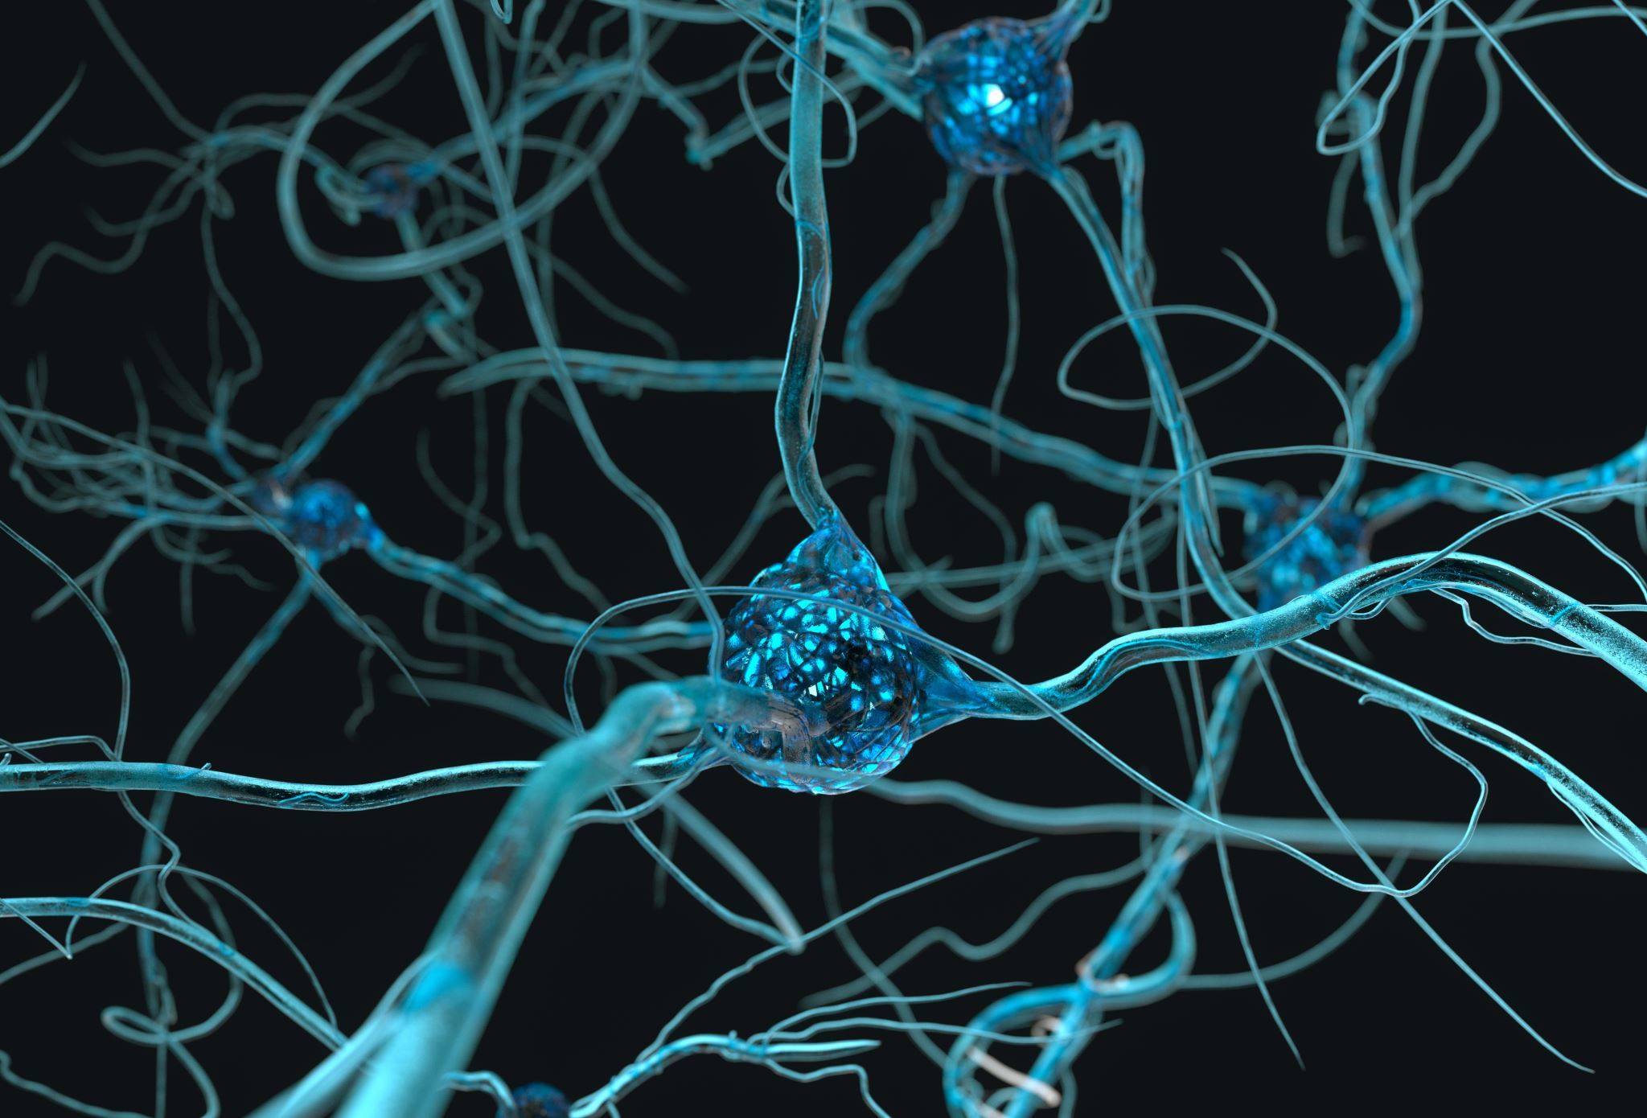
CONTENTS
Introduction
Related Works
Dendritic Neuron Model with Mask
Composing Networks Using Dendritic Neural Models
4.1 Multilayer Dendritic Neuron Model
4.2 Dendritic Deep Residual Network
4.3 Recurrent Dendritic Neural Network
Conclusion
Notes:
I will explain the following 5 sections in detail

Slide 3
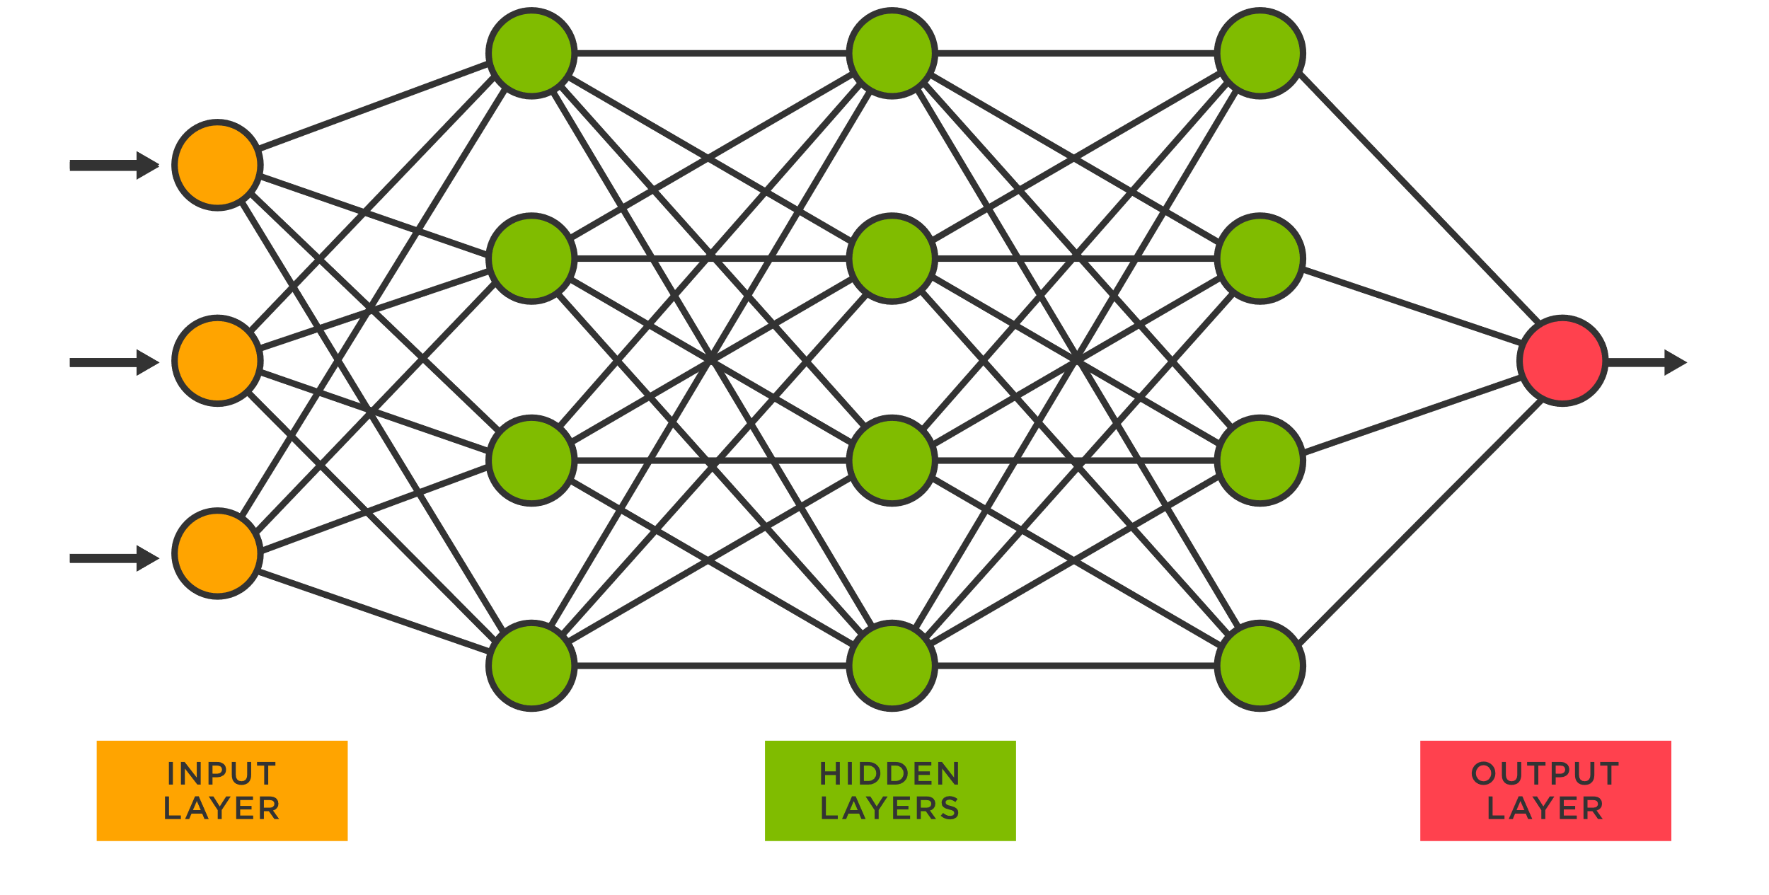
1
Introduction
Deep
Learning
Model
？？
Deep Learning has the property of black box, so studying the interpretability of deep learning is still a challenge.
The basic unit for building deep learning models is the McCulloch-Pitts (MP) neuron. However, MP neurons are too simple and highly different from biological neurons.
Black Box
Notes:
First is Introduction
In recent years, deep learning has become the focus of people.
While deep learning has the property of black box, studying the interpretability of deep learning is still a challenge.
Currently, most deep learning models are built with MP neurons. However, MP neurons are too simple and highly different from biological neurons.
# time = 1

Slide 4
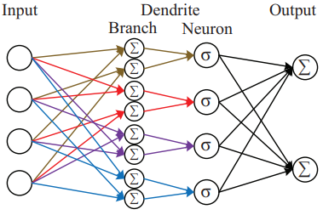
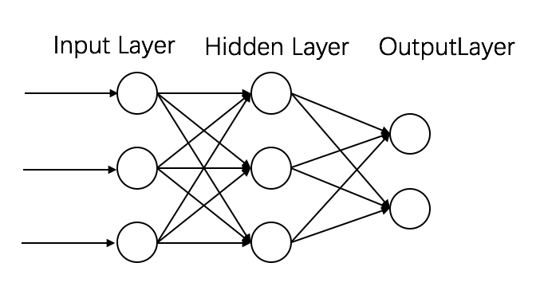
1
Introduction
improve
How to improve MP neurons has become a popular research topic. Many researchers have made improvements to MP neurons but have not been widely disseminated.
Notes:
How to improve MP neurons has become a popular research topic.
Many researchers have made improvements to MP neurons but have not been widely disseminated.
### 改进MP原因
(The improvement of MP neurons can improve the computational performance of individual neurons and increase the network's interpretability.)

Slide 5
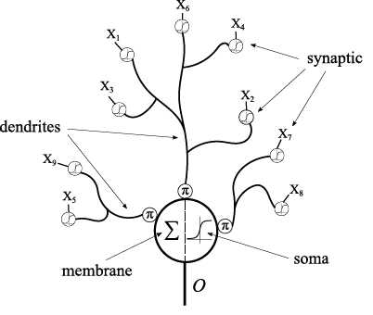
1
Introduction
Recently, Dendritic Neuron Model (DNM) has been widely studied. In many practical problems, DNM can achieve good results.
wind power forecasting
house price forecasting
exchange rate forecasting
prediction
…
Solve
classification
Diagnosis of breast cancer
…
Notes:
Recently, a more complex model than the MP neuron, the dendritic neuron model (DNM), has been widely studied.
In many practical problems, DNM can achieve good results.
Such as some prediction and classification problems.
### DNM相比MP神经元更接近生物学
MP neurons ignore the presence of dendrites that have high computational power in biological neurons. Instead, DNM is more similar to real neurons, and even a single neuron model can be used to handle nonlinear problems.
### DNM应用
For example, in various classification problems and prediction problems.
On the medical side, DNM has been effective in addressing the diagnosis of breast cancer and liver disease. In regression problems, DNM also has some advantages in forecasting various time series problems. For example, wind power forecasting, house price forecasting, exchange rate forecasting, stock market forecast, etc.

Slide 6

1
Introduction
However, DNM still has some issues, such as:
In most cases, DNM need to be trained using evolutionary algorithms (EA) to achieve the best results. EA limits the increase of DNM parameters.
The computational power of a single DNM is limited and it is currently impossible to form complex network with multiple DNMs.
Notes:
However, DNM still has some intractable problems, such as:
1. In most cases, DNMs need to be trained using evolutionary algorithms to achieve the best results, but EA limits the increase of DNM parameters.
(with slow training speed and few parameters.)
2. The computational power of a single DNM is limited and it is currently impossible to form complex network with multiple DNMs.
# time = 2.4

Slide 7
1
Introduction
Contribution
We propose to improve DNM by adding Mask mechanism to the dendritic layer, named DNM-M.
Use DNM-M to form multilayer dendritic neural network(MDNM).
Use DNM as a classifier of ResNet to better solve the detection problem of COVID-19.
Use DNM-M as the base unit to compose Recurrent Dendritic Neural Network (RDNN), which can have stronger prediction ability.
Notes:
This paper contributes as follows:
1. We propose to improve DNM by adding Mask mechanism to the dendritic layer, named DNM-M.
2. Use DNM-M to form multilayer dendritic neural network.
3. Use DNM as classifier of ResNet to better solve COVID-19 classification problem.
4. Use DNM-M as the base unit to compose RDNN, which can have stronger prediction ability.
# time = 3

Slide 8
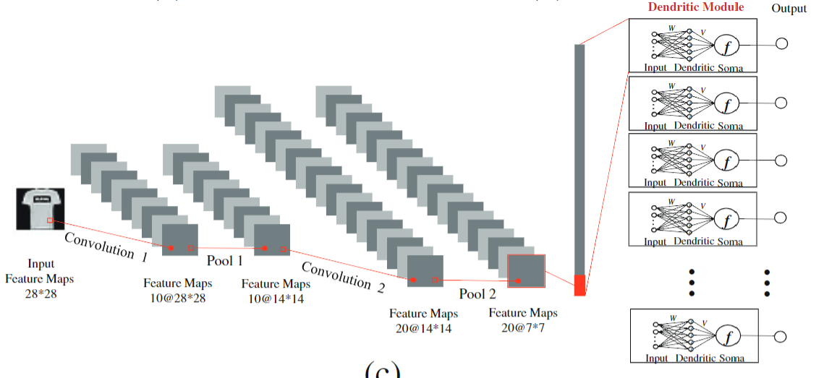
2
Related Works
We list some related studies on improving the structure of DNM.
Some researchers adds DNM as a classifier into CNN, proposed Dendritic Convolutional Neural Network (DCNN).
DCNN has achieved good results on MNIST, CIFAR10 and CIFAR100 datasets, and has some advantages over the traditional CNN model.
Notes:
We list some related studies on improving the structure of DNM.
Some researchers adds DNM as a classifier into CNN, proposed Dendritic Convolutional Neural Network (DCNN).
DCNN has achieved good results on MNIST, CIFAR10 and CIFAR100 datasets, and has some advantages over the traditional CNN model.

Slide 9
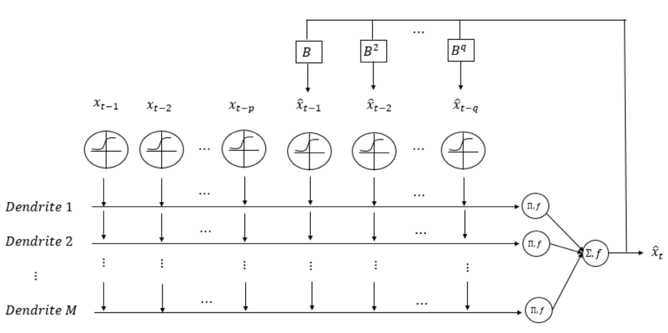
2
Related Works
Some researchers have proposed to form recurrent neural networks (RNN) with DNM. Using the output of DNM as part of the next input is named as RDNM-ANN.
It has achieved good results on some time series prediction problems. However, RDNM-ANN is still a single DNM structure.
Notes:
Some researchers have proposed to form recurrent neural networks (RNN) with DNM. Using the output of DNM as part of the next input is named as RDNM-ANN.
It has achieved good results on some time series prediction problems. However, RDNM-ANN is still a single DNM structure. (Although in terms of inputs and outputs, it has variations similar to RNN.)
# time = 4.4

Slide 10
3
Dendritic Neuron Model with Mask
What limits the DNM composition network
The EA brings higher performance to DNM, but also limits the increase of DNM parameters, thus limiting the use of DNM to build neural networks.
The back propagation (BP) algorithm is only applicable in DNM for some simple problems with small input dimensions. Since the DNM dendritic layer uses accumulative multiplication, which tends to cause gradient clustering during backpropagation.
Few parameters
No network
EA → →
∏
Error:
gradient clustering
BP + →
accumulative multiplication
Notes:
So, What limits the DNM composition network？
The EA brings higher performance to DNM, but also limits the increase of DNM parameters, thus limiting the use of DNM to build neural networks.
The back propagation (BP) algorithm is only applicable in DNM for some simple problems with small input dimensions. Since the DNM dendritic layer uses accumulative multiplication, which tends to cause gradient clustering during backpropagation.
# time = 5.5
### 以前的研究为什么不行
The related study did not address the problem of forming networks using DNM. It can only compose simple networks with small input dimensions.

Slide 11
3
Dendritic Neuron Model with Mask
Therefore, if want to use DNM to form a neural network, the following two problems need to be solved:
Use BP algorithm as the learning algorithm of the network.
Remove the accumulative multiplication from the dendritic layer of DNM.
Notes:
Therefore, if want to use DNM to form a neural network, the following two problems need to be solved:
Use BP algorithm as the learning algorithm of the network.
Remove the accumulative multiplication from the dendritic layer of DNM.
# time = 6

Slide 12
3
Dendritic Neuron Model with Mask
 | Learing Algorithm | Dendritic Layer
DNM | EA
DNM-M | BP
X₁ X₂
∏
Mask
X₁ X₂
∑
×
Notes:
We propose an improved DNM called DNM-M, which can be trained with the BP algorithm.
As shown in the table, the dendritic layer of the traditional DNM uses accumulative multiplication. And the learning algorithm usually use evolutionary algorithm.
Our proposed DNM-M changes the accumulative multiplication to accumulation.
But accumulation lacks the nonlinear processing of information. So, we propose the Mask mechanism for increasing the computational capability of the dendritic layer.
# time = 7

Slide 13
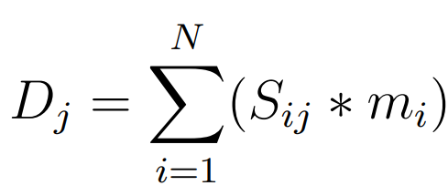
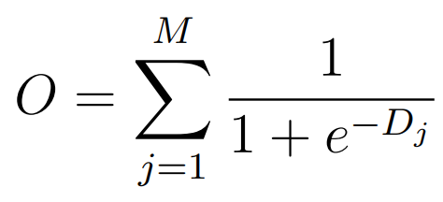
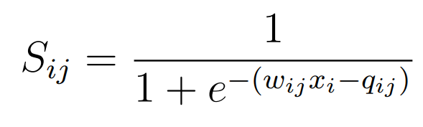
3
Dendritic Neuron Model with Mask
Mask
X₁ | X₂ | X₃ | X_{N}
…
…
∑
Dendritic 1
×
Dendritic 2
×
∑
∑
O
×
∑
Dendritic 3
…
Dendritic M
×
∑
Notes:
This picture shows the structure of DNM-M. And we list the formulas for each layer of DNM-M.
We multiply Mask with the information from the synaptic layer and summarize the information on the dendrites using accumulation.
### 解释DNM-M
In the synaptic layer, we use a sigmoid function to process the input X.
In the dendritic layer, we multiply Mask with the information from the synaptic layer and summarize the information on the dendrites using accumulation.
In the Soma layer, we used a sigmoid function transformation for each dendritic layer and summed the results using accumulation.
# time = 7.5

Slide 14
4
Composing Networks Using Dendritic Neural Models
We can use DNM-M as the basic unit to compose a neural network, thereby solving the problem that is difficult to be solved with a single DNM.
In this section, we introduce the three types of networks we propose.:
4.1 Multilayer Dendritic Neuron Model (MDNM)
4.2 Dendritic Deep Residual Network (DResNet)
4.3 and Recurrent Dendritic Neural Network (RDNN)
For easier understanding, we present the corresponding experiments after each model is introduced.
Notes:
Now, We can use DNM-M as the basic unit to compose a neural network, thereby solving the problem that is difficult to be solved with a single DNM.
Next, we introduce the three types of networks we propose. They can be used to solve different problems. They are MDNM, DResNet, and RDNN.
For easier understanding, we present the corresponding experiments after each model is introduced.
# time = 8.5
(We designed DNM-M with the ability to build complex neural networks.)

Slide 15
4.1
Multilayer Dendritic Neuron Model
The multilayer perceptron (MLP) is one of the most superficial types of neural networks.
Therefore, we use DNM-M as the base neuron to build a Multilayer Dendritic Neural Model (MDNM). This model is similar to MLP but has improved performance.
MLP
Notes:
The multilayer perceptron (MLP) is one of the most superficial types of neural networks.
Therefore, we use DNM-M as the base neuron to build a Multilayer Dendritic Neural Model (MDNM). This model is similar to MLP but has improved performance.
# time = 8.9

Slide 16
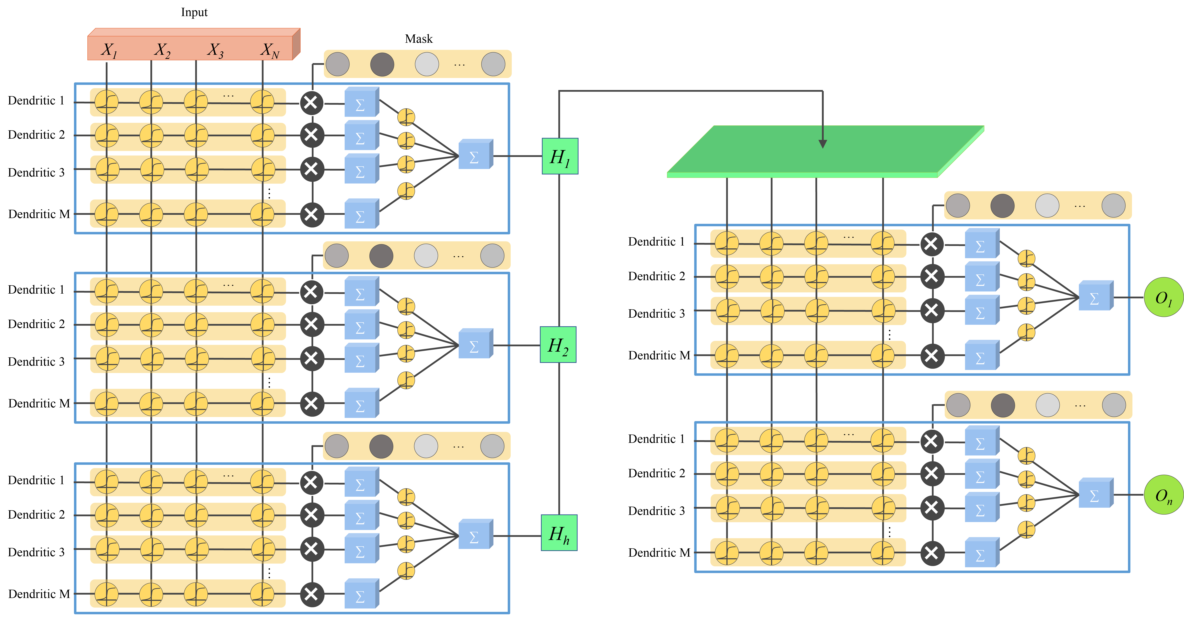
4.1
Multilayer Dendritic Neuron Model
Notes:
This figure shows the structure of MDNM with two layers of DNM-M units.
The first layer uses h DNMs to process the input information, and the output of the first layer is used as input to the second layer.
# time = 9.3
### MDNM参数
We use the simplest two-layer MDNM for our experiments, with the size of the first layer as 32 and the second layer as the output layer, which is set to 2 because these are binary classification problems. The M of MDNM and DNMs are set to 5.

Slide 17
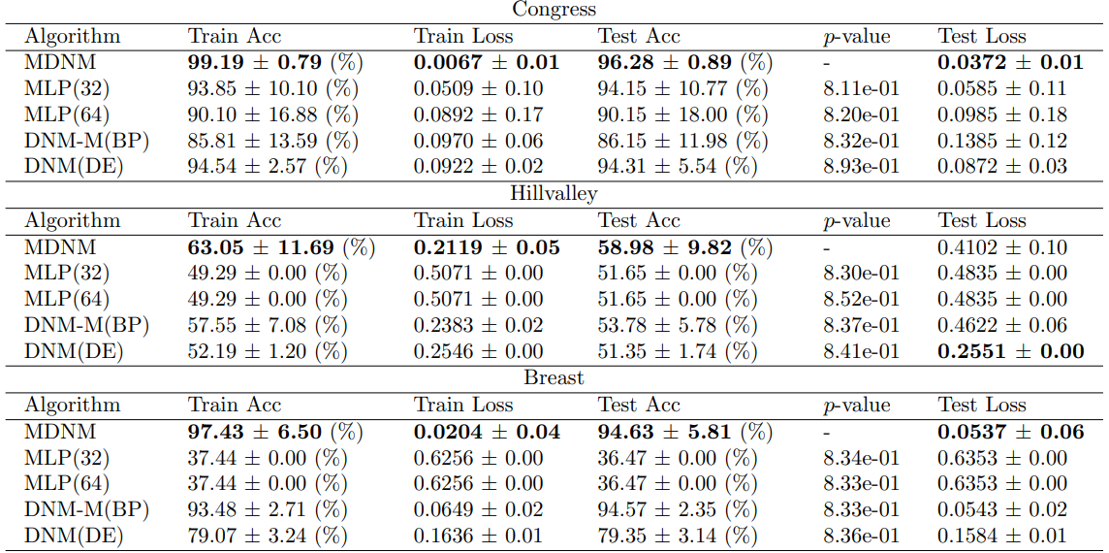
4.1
Multilayer Dendritic Neuron Model (Experimental Results)
 | Optimal Number
MDNM(32) | 8
MLP(32) | 1
MLP(64) | 1
DNM-M(BP) | 2
DNM(DE) | 1
…
Notes:
We experimented MDNM with other comparison models on 13 classification datasets from UCI.
We list the accuracy and loss obtained from some datasets in the table. For the full dataset results, please refer to Table 6.1 and Table 6.2 in the paper.
For ease of understanding, the table on the right shows the best number of each model in the test set for each of the 13 datasets. It can be seen that MDNM performs best in 8 of the data sets, significantly outperforming the other models.
# time = 10
### MDNM参数
We use the simplest two-layer MDNM for our experiments, with the size of the first layer as 32 and the second layer as the output layer, which is set to 2 because these are binary classification problems. The M of MDNM and DNMs are set to 5.
### 对比算法
The comparison models are MLP with hidden layer size of 32 and 64, DNM-M using BP algorithm and a DNM using differential evolution (DE) algorithm.

Slide 18
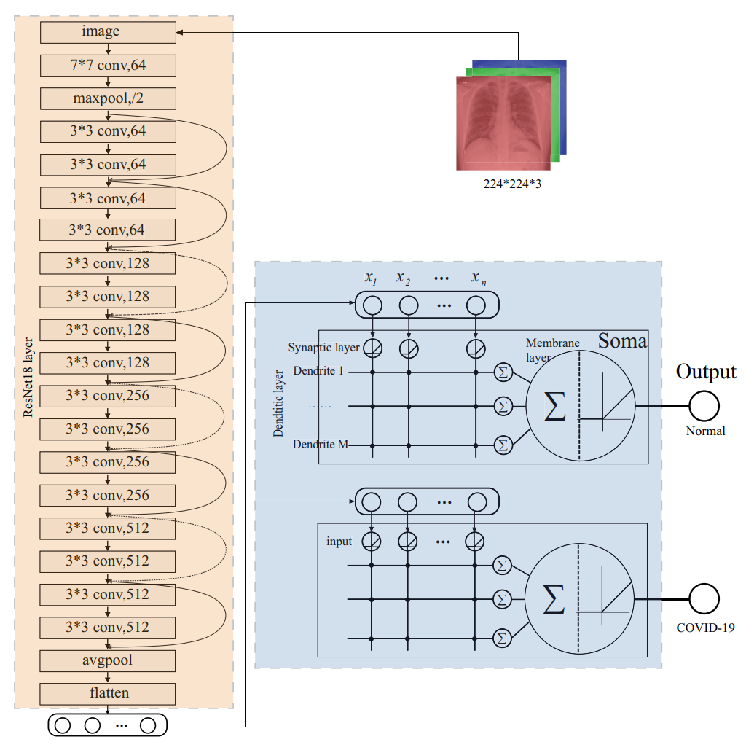
4.2
Dendritic Deep Residual Network
In previous research, there have been experiments using CNNs as information extractors and a DNM as classifier.
We take further on this basis and propose the Dendritic Deep Residual Network (DResNet) using ResNet as the information extractor and DNM units as the classifier.
Notes:
In previous research, there have been experiments using CNNs as information extractors and a DNM as classifier.
We take further on this basis and propose the DResNet.
The figure shows the structure of DResNet, divided into ResNet layer as the information extractor and DNM layeras the classifier.

Slide 19
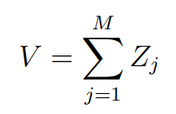
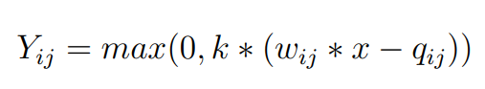
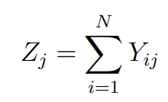
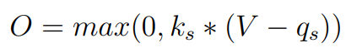
4.2
Dendritic Deep Residual Network
X₁ | X₂ | X₃ | X_{N}
…
∑
Dendritic 1
Dendritic 2
∑
∑
O
∑
Dendritic 3
…
Dendritic M
∑
ReLU
ReLU
Notes:
In the DNM layer, we have improved DNM to better process the information.
The figure shows the structure of the DNM used in DResNet.
We replace the Sigmoid function in the traditional DNM with the ReLU function and replace the accumulative multiplication of dendritic layer with accumulation.
# time = 11

Slide 20
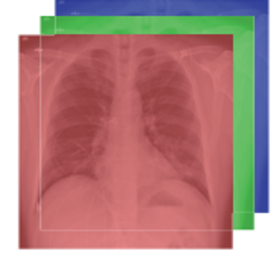
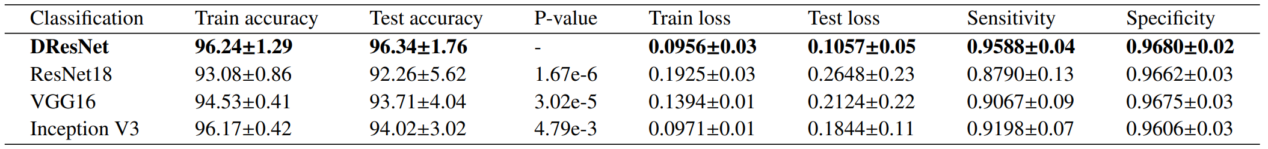
4.2
Dendritic Deep Residual Network (Experimental Results)
We used DResNet to detect the presence of COVID-19 by imaging the patient's lungs. We use the COVID-19 Radiography Database from kaggle.
 | Number of data
COVID-19 | 3616
normal | 10192
 | proportions
Train : Test | 80% : 20%
Input size
224*224*3
Notes:
We used DResNet to predict the presence with or without COVID-19 by imaging the patient's lungs. We use the COVID-19 Radiography Database from kaggle.
The following table gives the experimental results of DResNet with other comparison models on the COVID-19 detection problem.
The table shows that in each of the metrics. DResNet significantly outperforms the other comparison models contain ResNet, VGG and Inception.
# time = 11.5
### 数据集划分
There are 3thousand COVID-19 positive cases and 1million normal cases.
We split the data into a train and a test set with the ratio of 80% and 20%, respectively.
The input images were converted to a size of 224*224 with 3-dimensional channels during data processing.

Slide 21
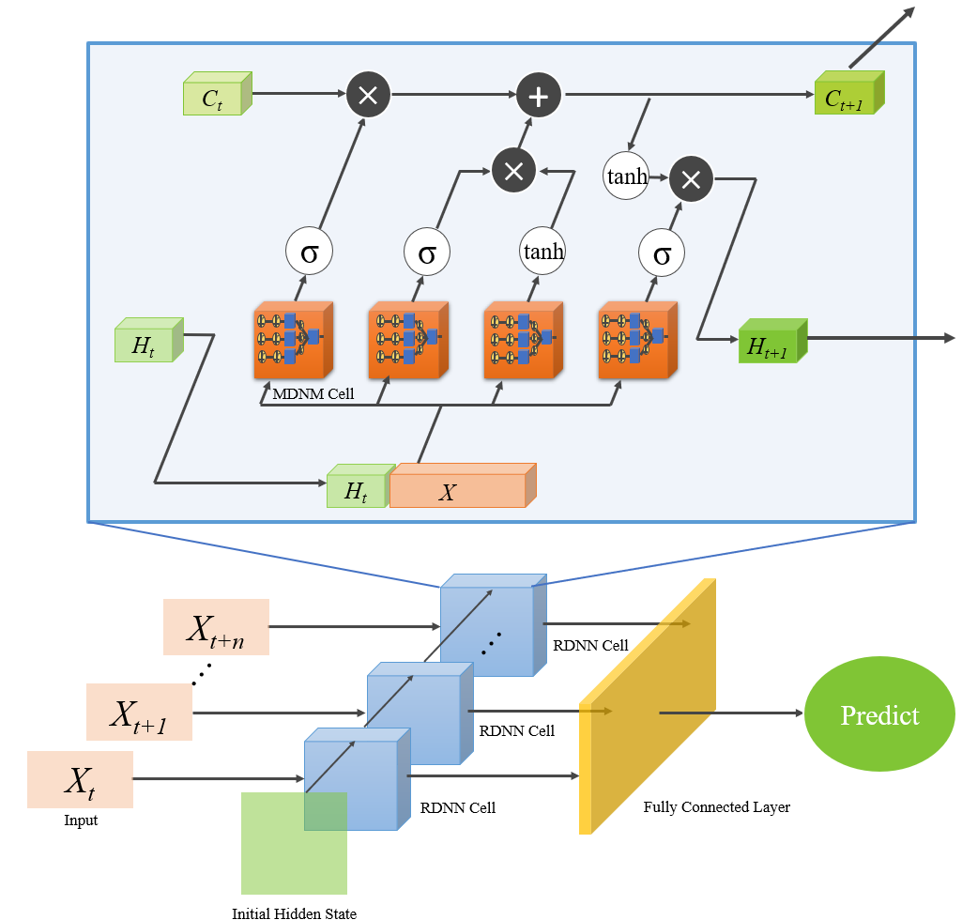
4.3
Recurrent Dendritic Neural Network
In this section, we propose a new recurrent neural network using DNM-M as the base unit, which we call recurrent dendritic neural network (RDNN).
The inputs at different moments are processed by the RDNN cell and passed to the fully connected layer to get the final output.
Notes:
In this section, we propose a new recurrent neural network using DNM-M as the base unit, which we call recurrent dendritic neural network (RDNN).
The structure of RDNN is shown in the figure.
Which X_{t} represents the input at time t.
The inputs at different moments are processed by the RDNN cell and passed to the fully connected layer to get the final output.
# time = 12.3

Slide 22
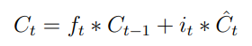
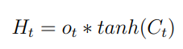
4.3
Recurrent Dendritic Neural Network
C_{t-1}
×
+
C_{t}
×
tanh
×
σ
σ
σ
f_{t}
i_{t}
ˆ
o_{t}
C_{t}
tanh
H_{t -1}
H_{t}
f_{t} | Forget gate
i_{t} | Input gate
C_{t} | Short term memory
o_{t} | Output gate
MDNM Cell
H_{t -1}
ˆ
X
RDNN Cell
Notes:
This figure shows the structure of the RDNN cell. The structure of RDNN cell is similar to LSTM, but it is built using DNM-M.
The RDNN cell has three gates: forget gate, Input gate and Output gate.
(And C_{t} for adding information to long-term memory.)
The formula for RDNN is given on the right.
# time = 13
### RDNN 详解
This line represents the long-term memory of RDNN.
Forget gate : forget gate determines which parts of C_{t-1(Subtraction)} to keep or forget.
Input gate: Input gate determine what new information can be stored in the C.
Short term memory: Short term memory Generating candidate memories.
Output gate: Output gates determine which part of long-term memory needs to be output.
# C 和 H 代表意义
memory cell Ct−1 and hidden state Ht−1

Slide 23
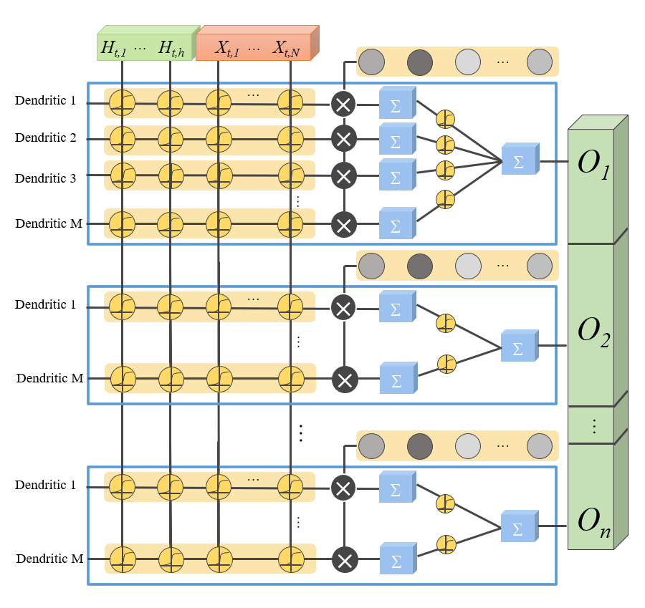
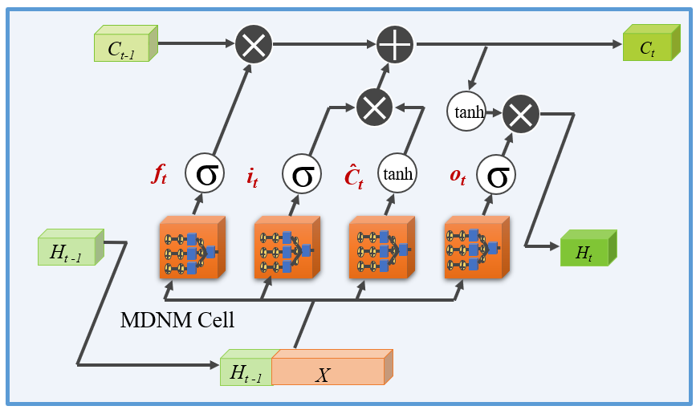
4.3
Recurrent Dendritic Neural Network
MDNM Cell consist of multiple DNM-M cells. Unlike the MDNM in 4.1, in order to improve the computational speed, only a single layer DNM is used in RDNN.
Notes:
Next we briefly introduce the MDNM Cell in the RDNN Cell.
MDNM Cell consist of multiple DNM-M cells. Unlike the previously mentioned multilayer DNM, in order to improve the computational speed, only a single layer DNM is used in RDNN.
# time = 13.5

Slide 24
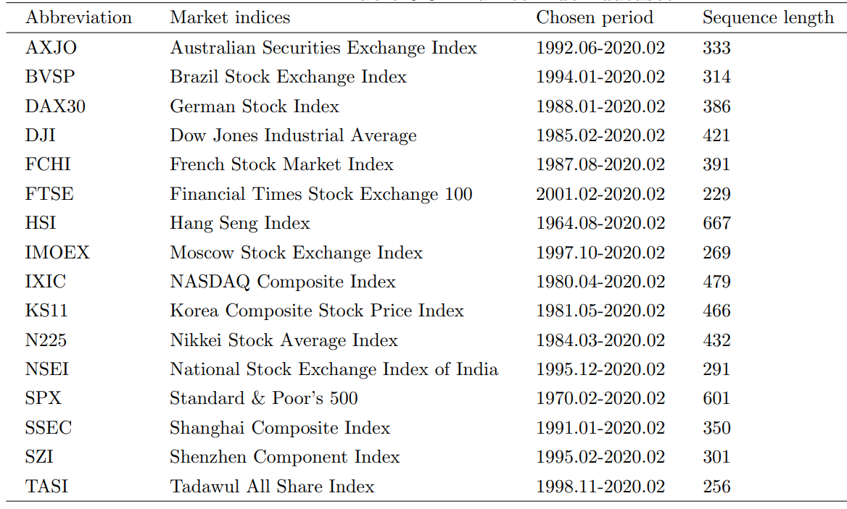
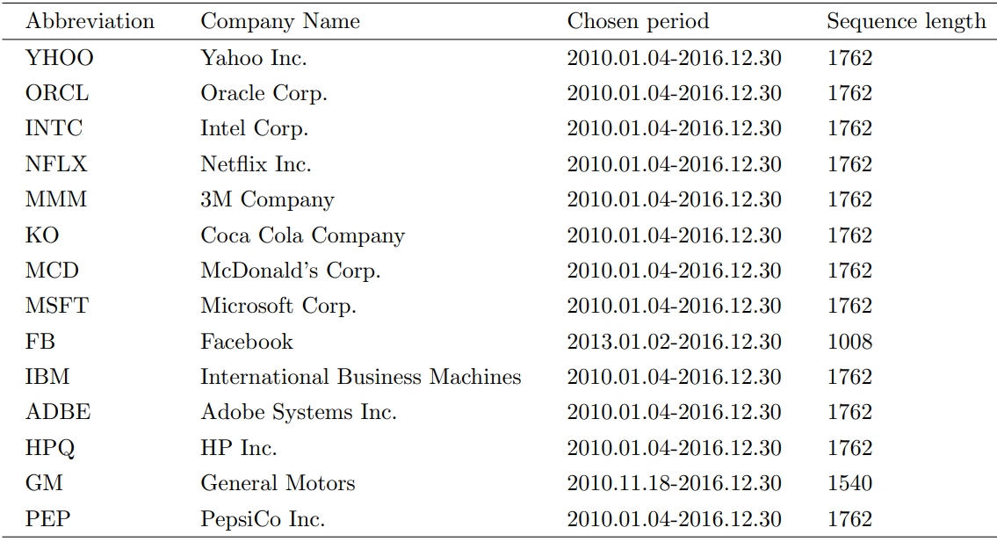
4.3
Recurrent Dendritic Neural Network
(Experimental Results)
We use RDNN to study the financial time series forecasting problem. We have used two types of datasets to better analyze the performance of the model.
Company stock dataset
Market index dataset
Notes:
We use RDNN to study the financial time series forecasting problem.
We have used two types of datasets to better analyze the performance of the model. They are Market index dataset and Company stock dataset, respectively.
The following two tables show the information of the datasets.
# time = 14.7
### 数据集的特点
The two datasets are stock index data for different countries and some company stock data. The stock index data is recorded monthly with a longer time span but a smaller total data volume. The company stock data is recorded on a daily basis and has a larger amount of data.

Slide 25
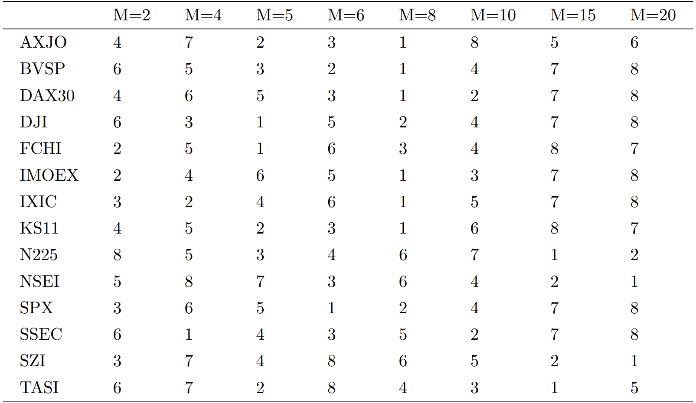
4.3
Recurrent Dendritic Neural Network
(Experimental Results)
Hyperparameter selection for RDNN
Notes:
In RDNN, the number of dendritic layers must be pre-set with hyperparameter M.
In the market index dataset, we conducted an experiment in selecting some common pre-defined M values. The result is shown in Table.
As we can see from this table, when M is set to 8, the results have the highest ranking. So we set M to 8 for subsequent experiments.
# time = 15

Slide 26
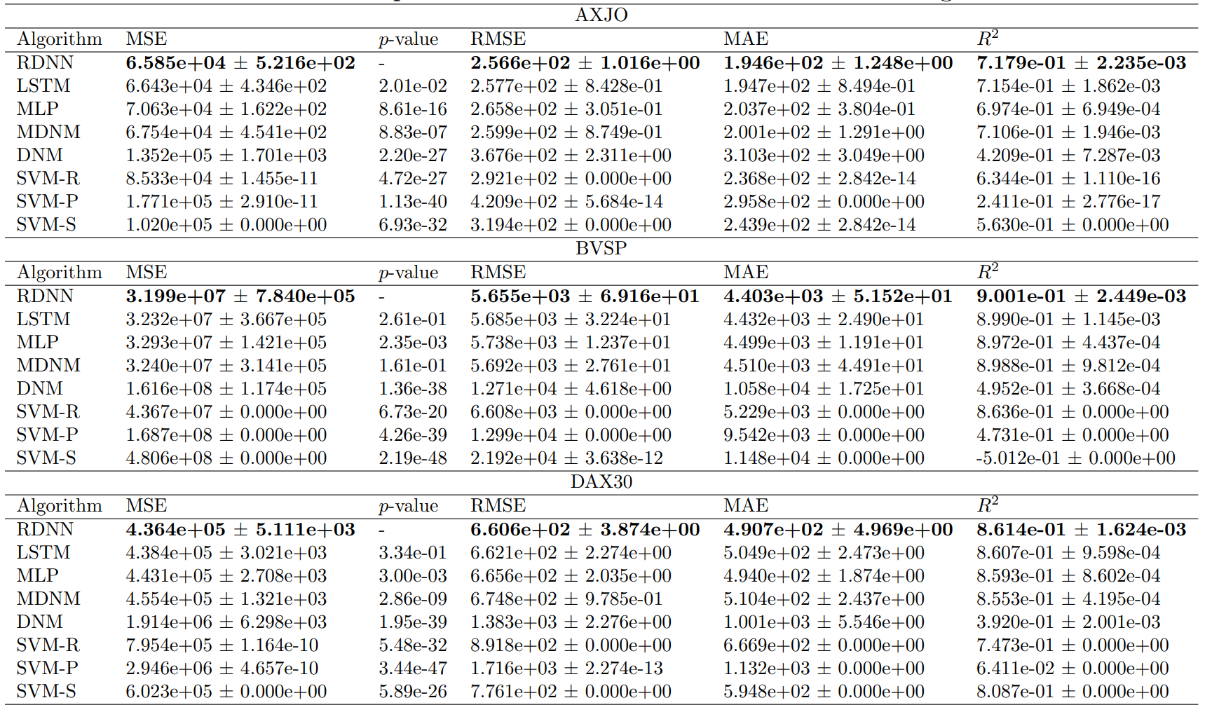
4.3
Recurrent Dendritic Neural Network
(Experimental Results)
Input time | Predict time
2 | 1
 | proportions
Train : Test | 80% : 20%
…
Notes:
We list results from some datasets in the table. For the full dataset results, please refer to Table 6.9 to Table 6.12 in the paper.
We use some popular timing prediction algorithms for comparison.
# time = 15.8
### 对比算法
The comparison methods we use are
Including LSTM, MLP with a hidden size of 64, MDNM, DNM and three types of SVM(Support Vector Machine)
, (which use an RBF kernel (SVM-R), a polynomial kernel (SVM-P) and a sigmoid kernel (SVM-S).
### 预测天数
For all methods we used the data from the first two days to predict the next day.
### 参数
hidden size = 8 (In practical problems, it works better to set it up this way)
### 评价指标 (Evaluation Metrics)
We list the mean-square error(MSE), root-mean-square error(RMSE), Mean Absolute Error(MAE), and R-Squared from some datasets in the table.

Slide 27
4.3
Recurrent Dendritic Neural Network
(Experimental Results)
Market index dataset
Company stock dataset
 | Optimal Number
RDNN | 8
LSTM | 1
MLP(64) | 3
MDNM | 3
DNM | 0
SVM-R | 0
SVM-P | 0
SVM-S | 1
 | Optimal Number
RDNN | 9
LSTM | 2
MLP(64) | 1
MDNM | 0
DNM | 0
SVM-R | 2
SVM-P | 0
SVM-S | 0
Notes:
These two tables show the best number of each model in the test set in the Market index dataset and Company stock dataset.
It can be seen that RDNN performs the best in both datasets, significantly outperforming the other models.
# time = 16

Slide 28
5
Conclusion
In conclusion, We propose DNM-M and three neural networks with DNM as the base unit. Also, we showed their performance through extensive experiments.
Meanwhile, this study opens the door for the following researches:
The basic DNM unit can be improved to fit different problems.
MDNM, DResNet and RDNN can be applied to other real-world problems.
DNM-M can be used as the basic unit to design more powerful neural networks.
Notes:
In conclusion, We propose DNM-M and three neural networks with DNM as the base unit. Also, we showed their performance through extensive experiments.
Meanwhile, this study opens the door for the following researches:
The basic DNM unit can be improved to fit different problems.
MDNM, DResNet and RDNN can be applied to other real-world problems.
DNM-M can be used as the basic unit to design more powerful neural networks.

Slide 29
Thanks
Notes:
The above is my thesis, thanks to all the teachers

Slide 30
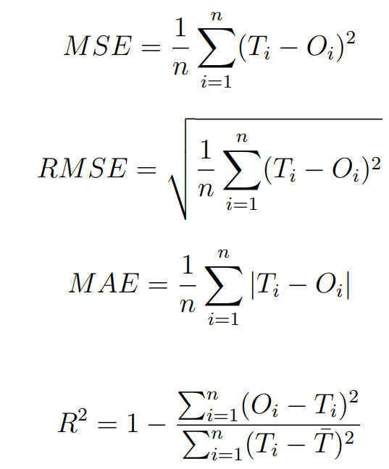
4.3
Recurrent Dendritic Neural Network
(Experimental Results)
Formula of evaluation function

Slide 31
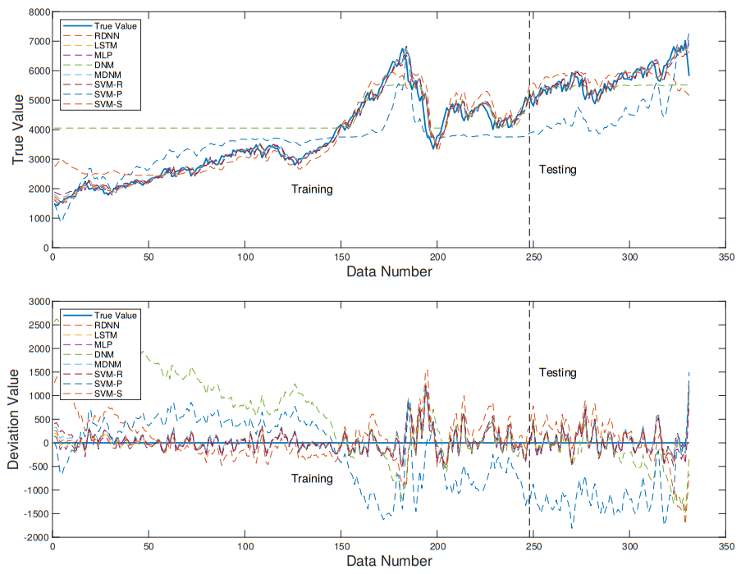
4.3
Recurrent Dendritic Neural Network
(Experimental Results)
Results of different models on AXJO dataset
Notes:
The blue line represents the true value of the stock. The red line is the value predicted by the RDNN.
True value minus predicted value.

Slide 32
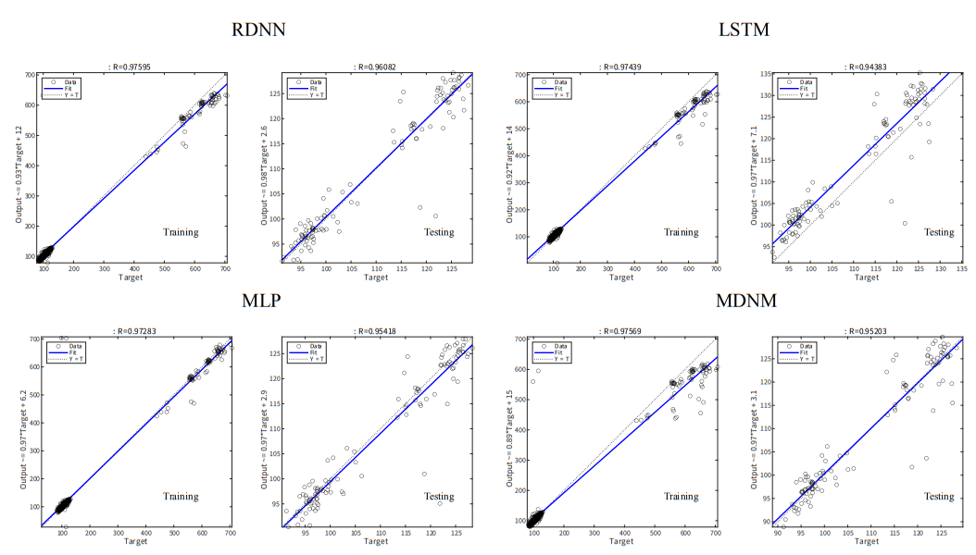
4.3
Recurrent Dendritic Neural Network
(Experimental Results)
Results of different models on NFLX dataset
Notes:
The dots represent the true values. The dotted line is the true value.
The blue line is fitted from the true value. More the blue line is close to the dashed line means that the model works better.

Slide 33
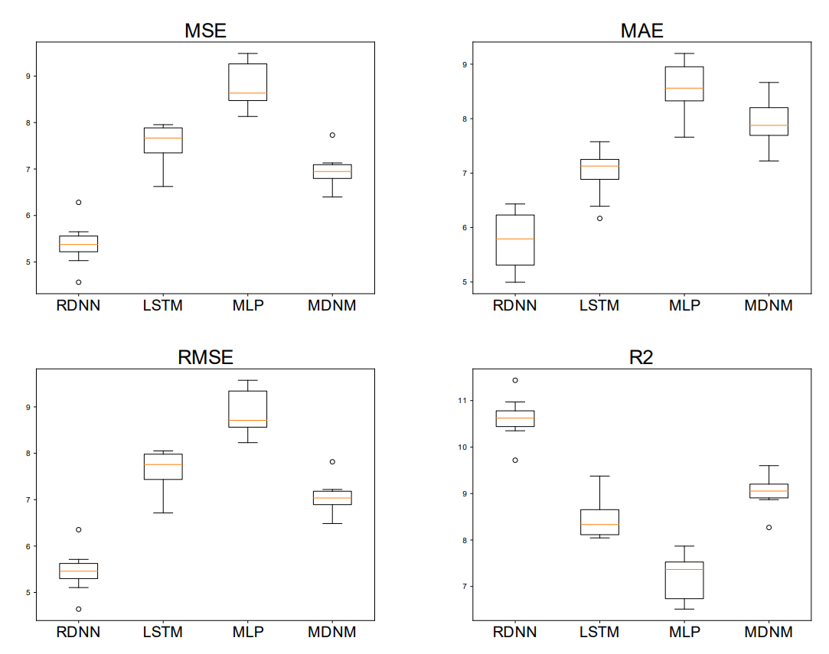
4.3
Recurrent Dendritic Neural Network
(Experimental Results)
Mean performance in 16 Market index datasets
Notes:
The best performance in each data set is recorded as 0 and the worst performance is recorded as 1.
The values obtained from the 16 data sets are summed to obtain the final value.

Slide 34
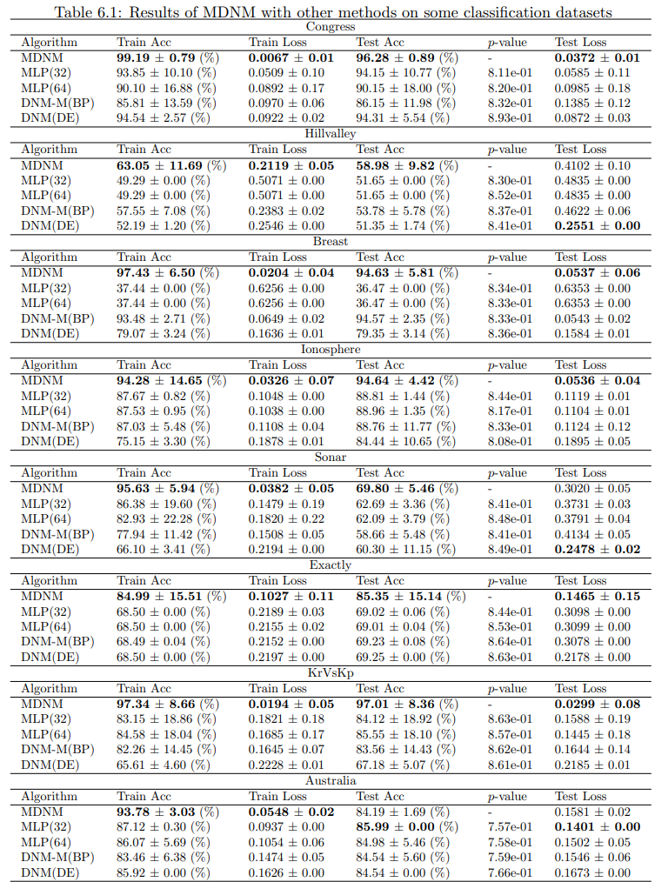
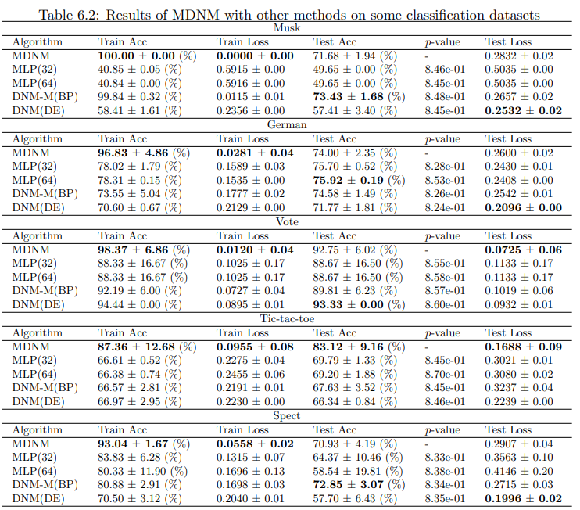

Slide 35
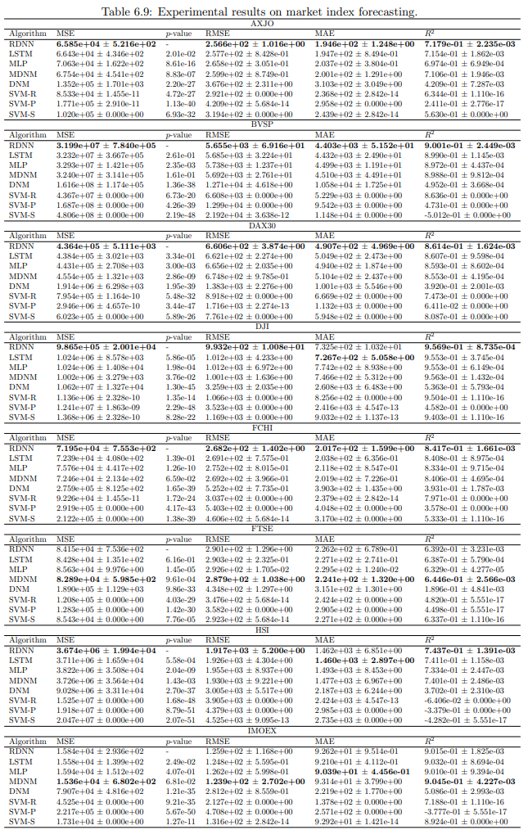
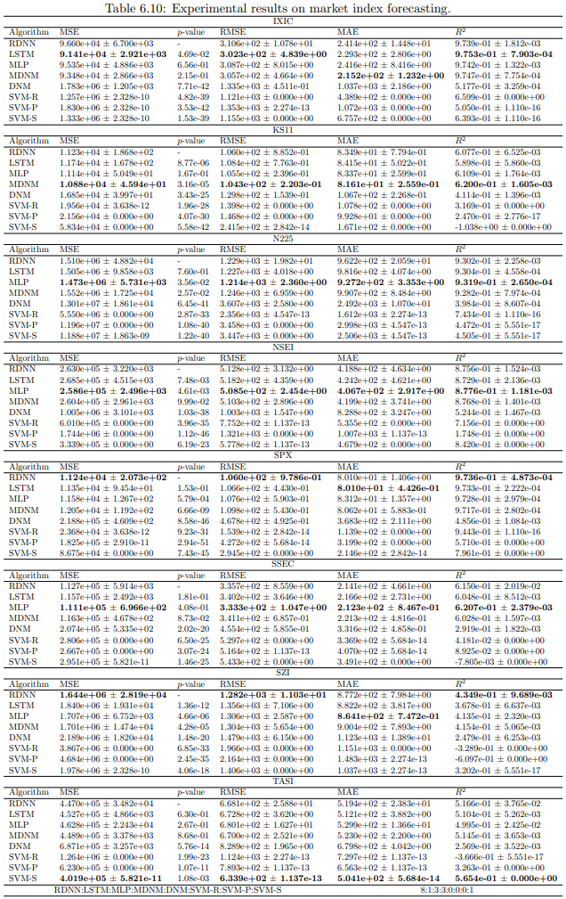

Slide 36
